Slide 1

Getting the Most out of SharePoint Patterns & Practices
February 10-13, 2019 ⏐ Austin, TX USA
Chris Kent
Office 365 Practice Lead, DMI

Slide 3















“Me”
Indianapolis, IN
Office Development
Office 365 Practice Lead
@theChrisKent
Member of the Core Team
theChrisKent.com
Notes:
Can I possibly get my name on a single slide even more? Wow.

Slide 4
Goals

Slide 5
Patterns & Practices
Why | What | How

Slide 6
Staying INFORMED
Videos | Calls | Updates

Slide 7
SHARING IS CARING
How to Contribute

Slide 8

2017
Deep Integration
SharePoint Dev Ecosystem = SharePoint PnP. End-to-end coordination of SharePoint development guidance and community activities.
2016
Partnership
PnP ownership moved to engineering as a partnership for aligning with the roadmap. Work with SPFx starts.
2015
Reusability
PnP Provisioning Engine, reusable components and solutions introduced. Weekly webcasts started.
2014
Going public
First CodePlex, then GitHub. Concentration on add-in model enterprise scenarios.
2013
Internal Initiative
Internal initiative within Microsoft to consolidate knowledge gained from the add-in model

Slide 9



Watch time in YouTube
2,007,981 minutes
Views in YouTube
333,547
High Level Statistics
2018
3.8
Years
High level statistics for the SharePoint Developer Ecosystem: Usage and community behavior across SharePoint Online, YouTube, and GitHub.

Slide 10

Watch time in YouTube
2,007,981 minutes
Views in YouTube
333,547
Unique visitors in GitHub
1,046,686
Views in GitHub
5,150,970
High Level Statistics
2018
Entire City of
AUSTIN
High level statistics for the SharePoint Developer Ecosystem: Usage and community behavior across SharePoint Online, YouTube, and GitHub.

Slide 11

Watch time in YouTube
2,007,981 minutes
Views in YouTube
333,547
4,135
Unique visitors in GitHub
1,046,686
Views in GitHub
5,150,970
High Level Statistics
2018
Views in docs.microsoft.com (SharePoint Dev)
10,162,130
Requests a Second
Most used capability Provisioning Engine
(3220 tenants)
PnP Reusable Component usage
Unique tenants
18,785
Http Requests
130.4 Billion
Http Requests
130.4 Billion
High level statistics for the SharePoint Developer Ecosystem: Usage and community behavior across SharePoint Online, YouTube, and GitHub.

Slide 12


Slide 13
























Radi Atanassov
@RadiAtanassov
Stefan Bauer
@StfBauer
Andrew Connell
@andrewconnell
Velin Georgiev
@VelinGeorgiev
Erwin van Hunen
@erwinvanhunen
Australia
Austria
USA
Ireland
Sweden
Bert Jansen
@O365Bert
Vesa Juvonen
@vesajuvonen
Chris Kent
@theChrisKent
Andrew Koltyakov
@AndrewKoltyakov
Waldek Mastykarz
@waldekm
Belgium
Finland
USA
Russia
Netherlands
CORE TEAM
Paolo Pialorsi
@PaoloPia
Patrick Rodgers
@mediocrebowler
Elio Struyf
@eliostruyf
Mikael Svenson
@mikaelsvenson
Italy
USA
Belgium
Norway

Slide 14

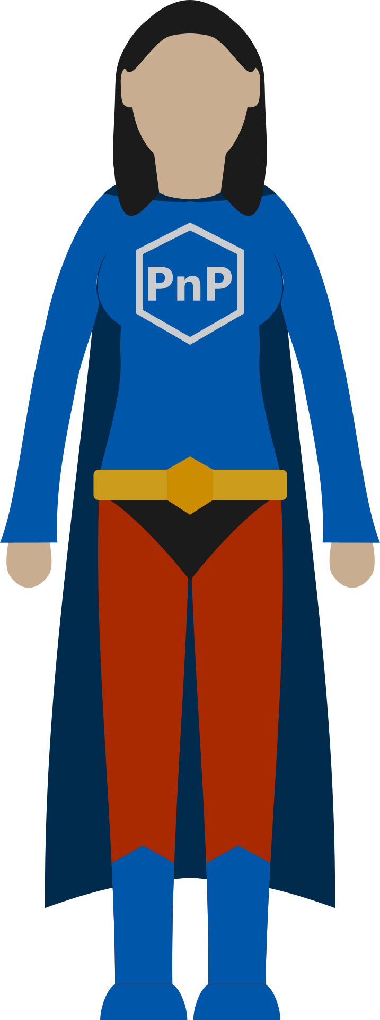
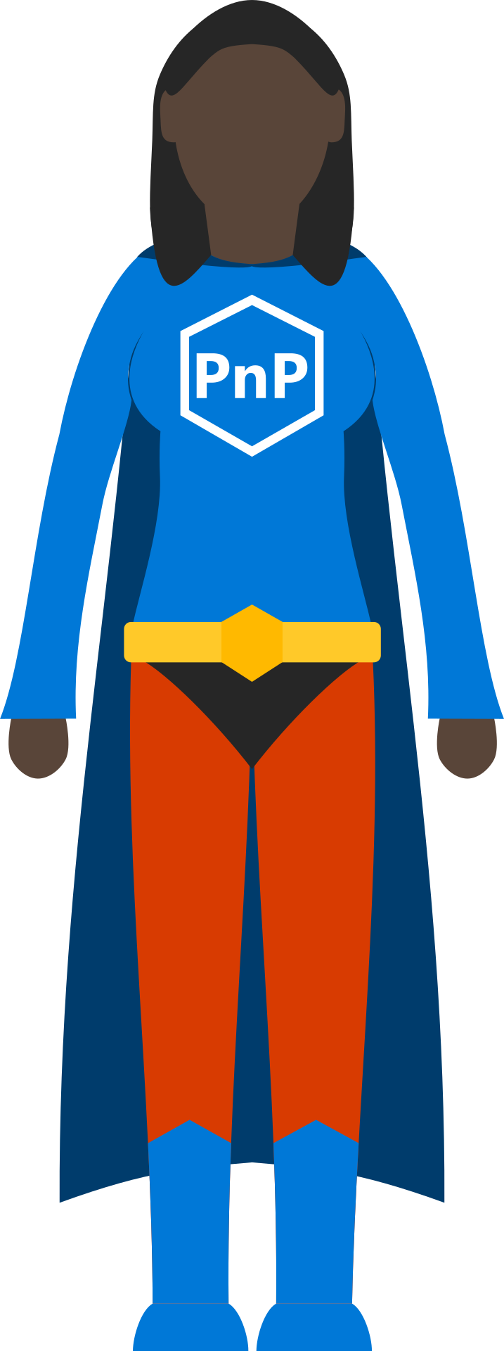
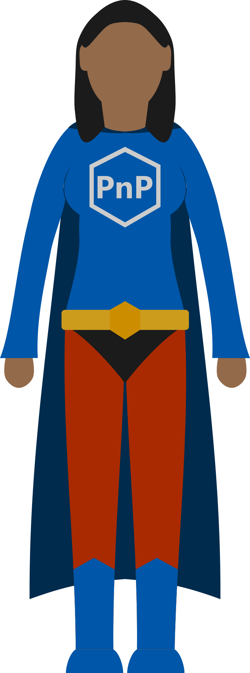
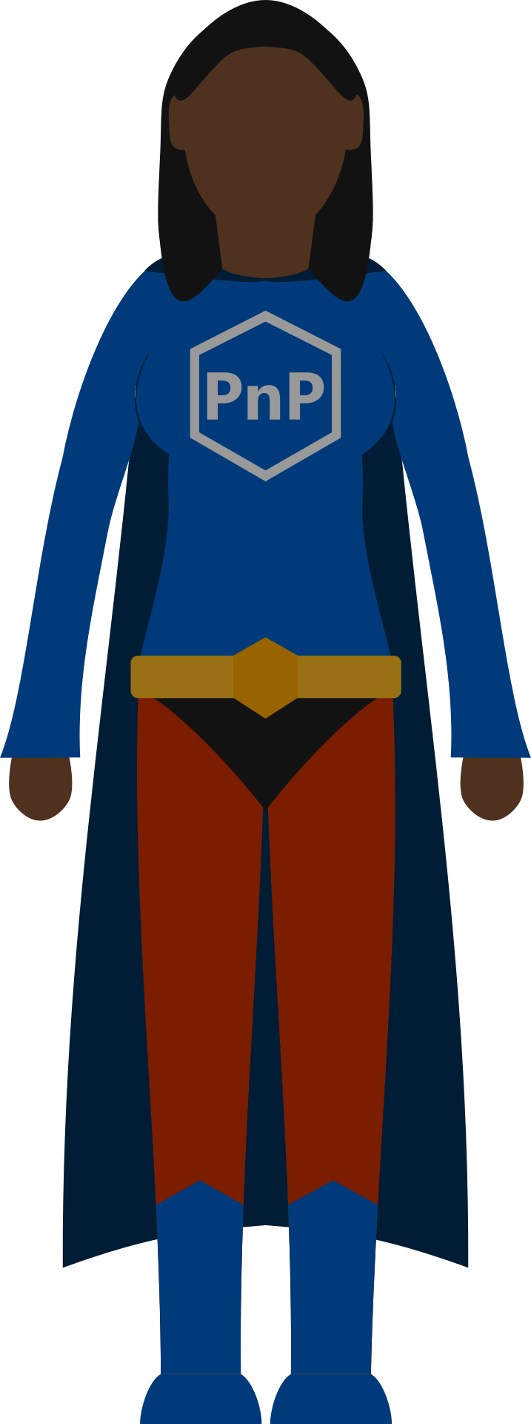
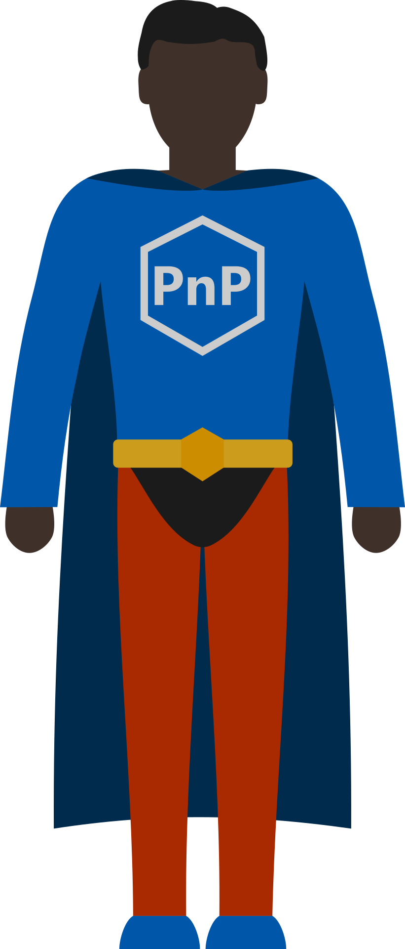
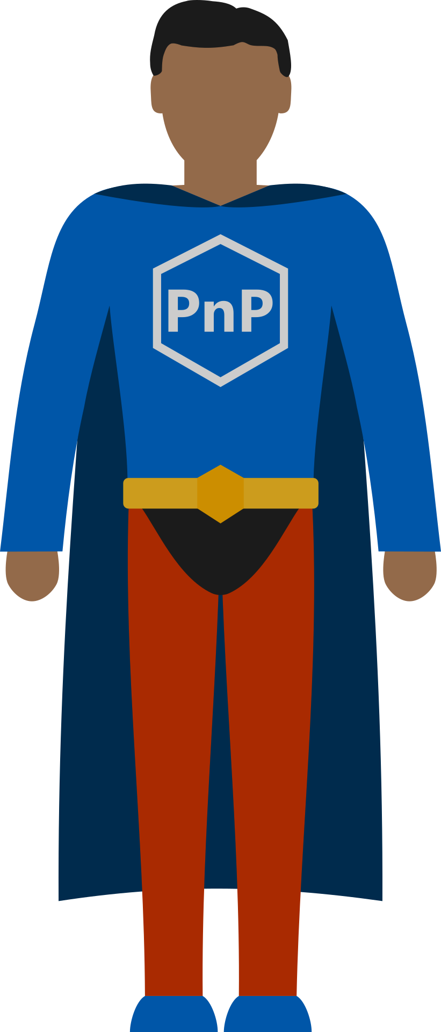
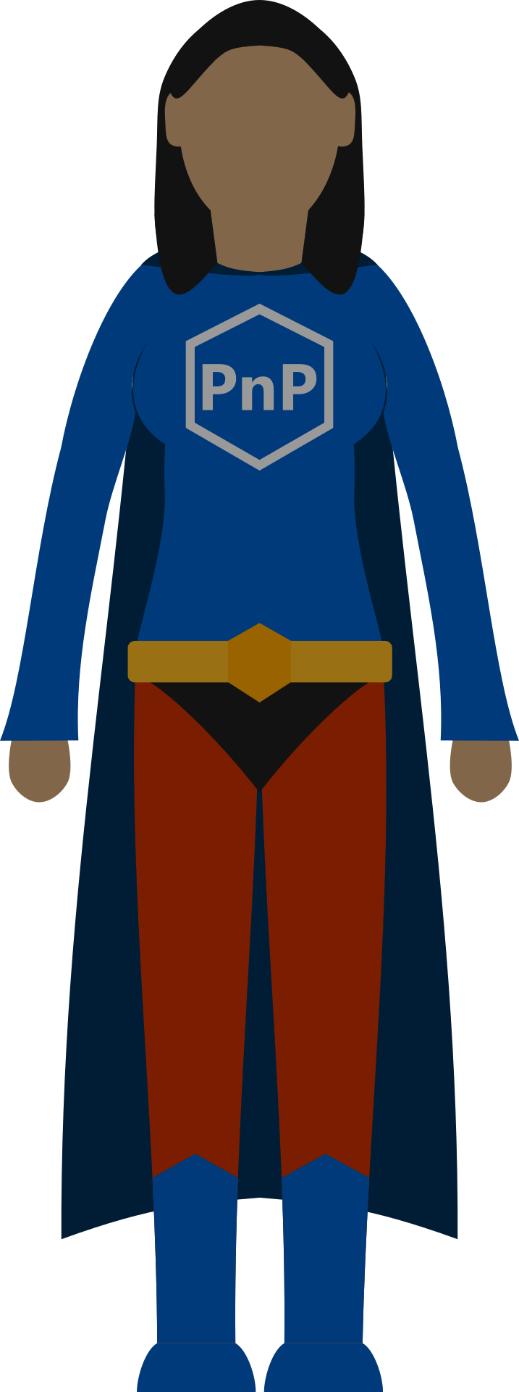
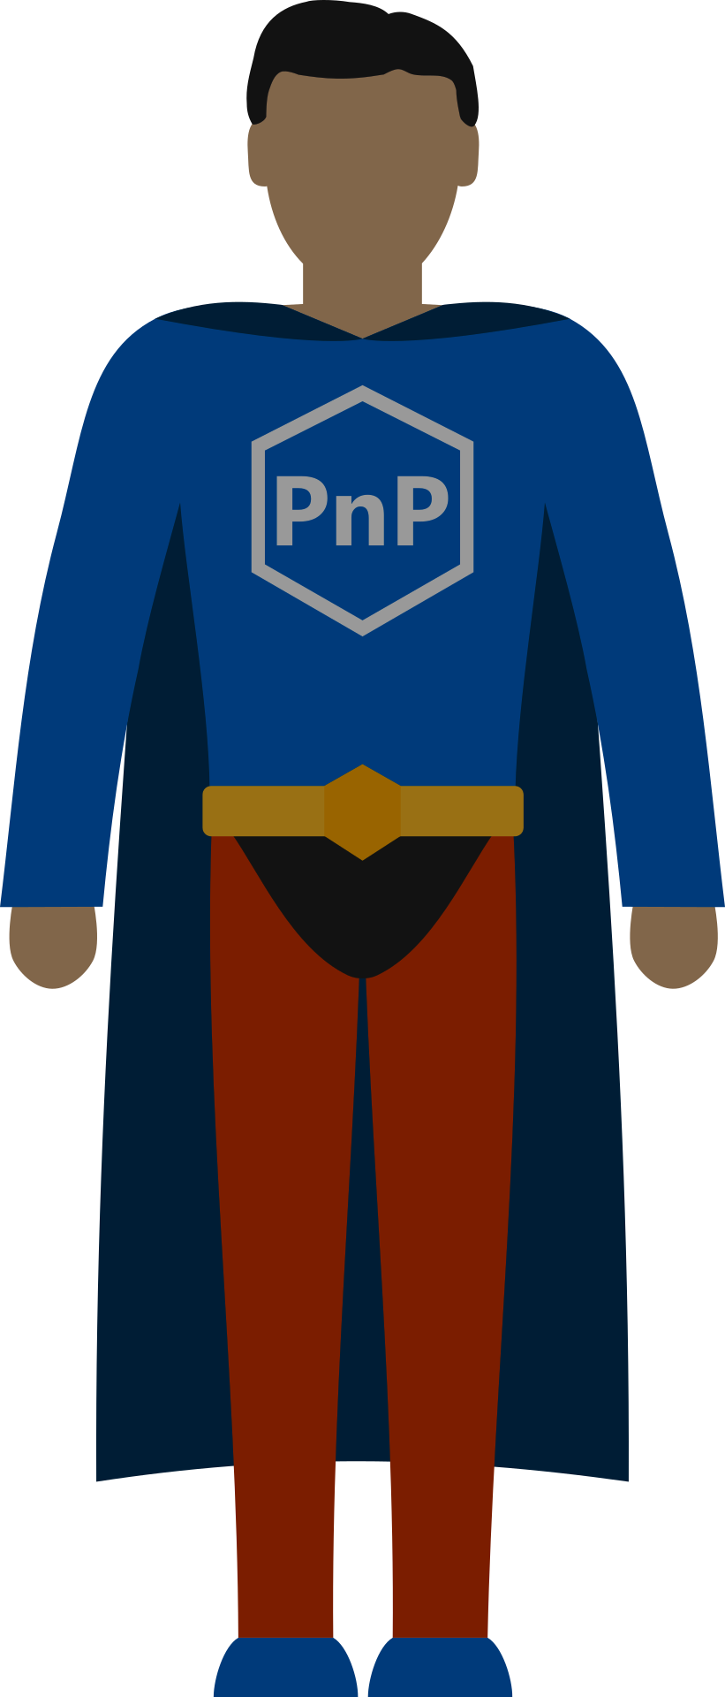
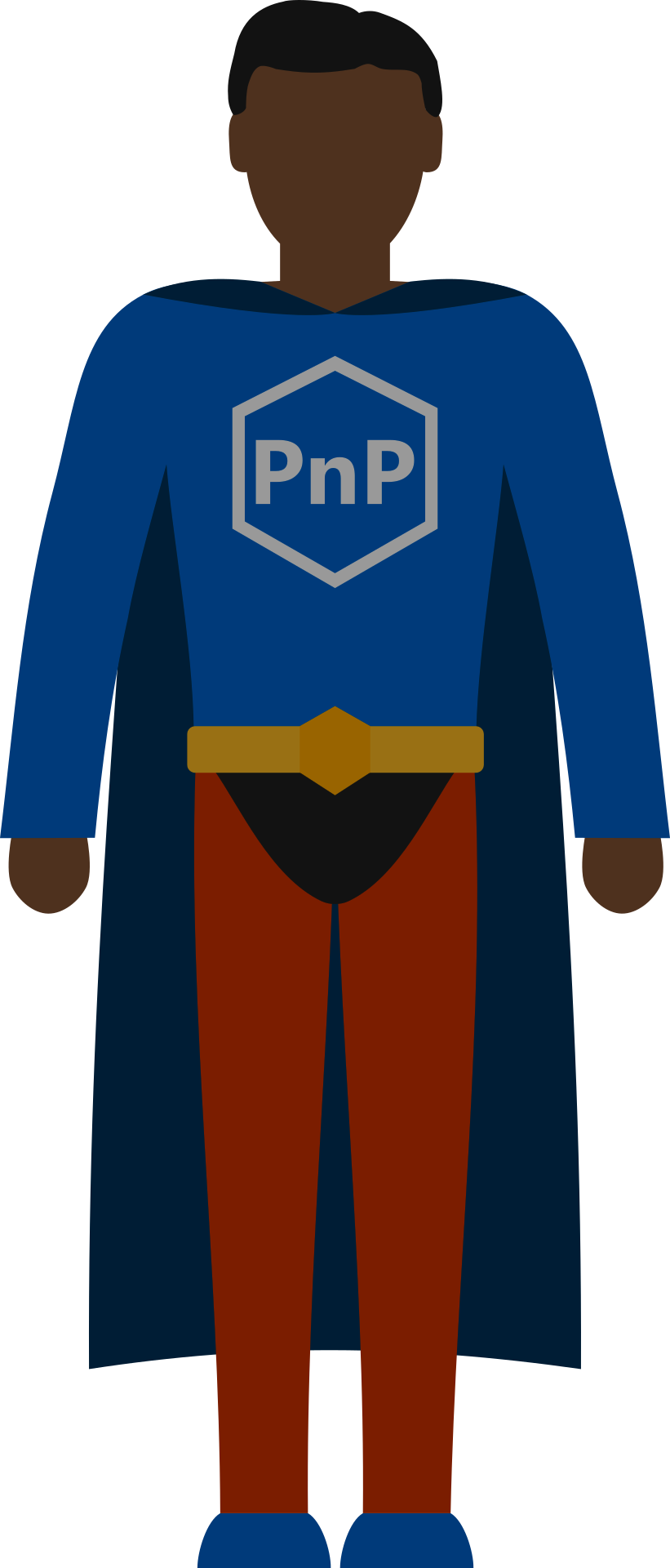
Sharing is Caring

Slide 15


Slide 16


Slide 17

aka.ms/sppnp

Slide 18
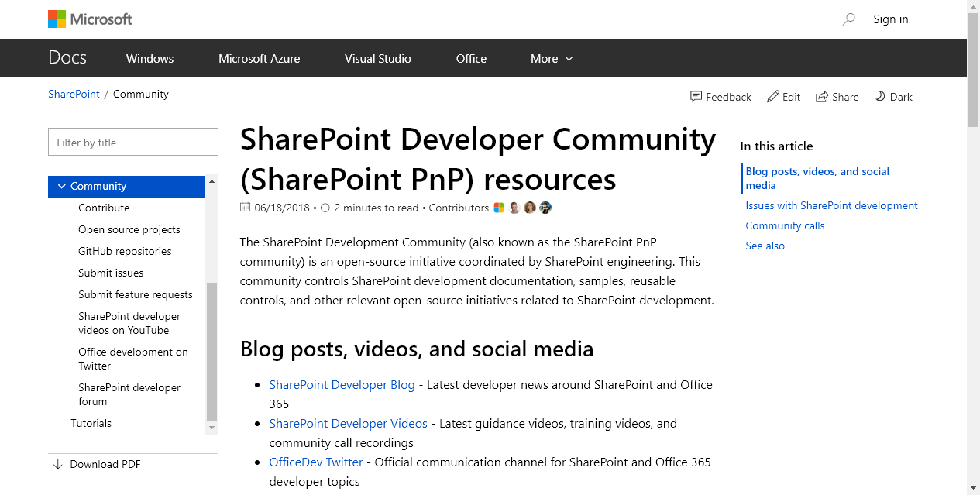

Slide 21

Documentation
Best Practices
Tutorials
Videos & Webcasts
Sample Solutions
Full Solutions
Use what makes sense
You don’t need to start at the “beginning”
PnP Guidance

Slide 22
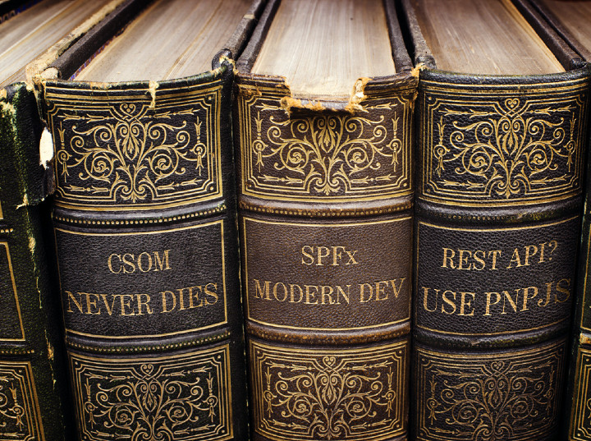
aka.ms/spdev-docs

Slide 23
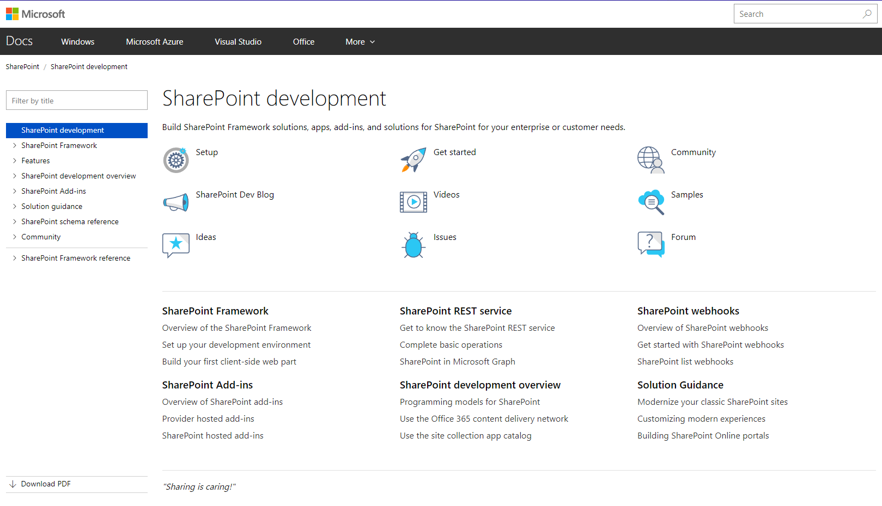

Slide 24
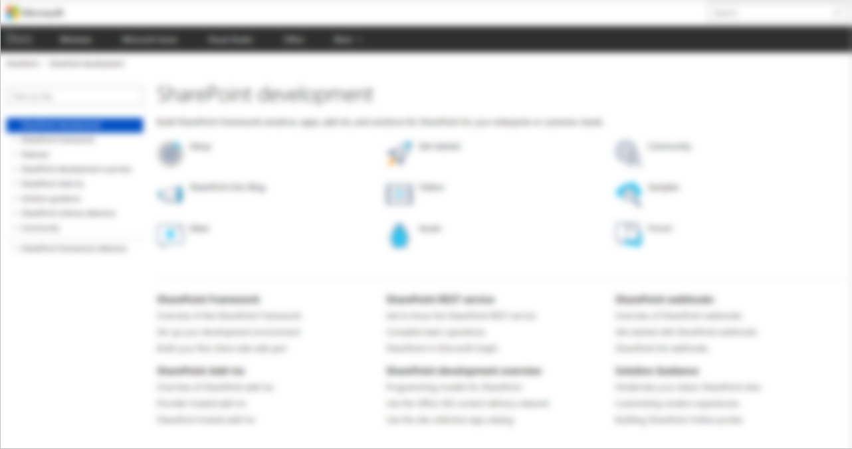

docs.microsoft.com/sharepoint
New consolidated platform
All active SharePoint development topics moved here
Content managed in GitHub
SharePoint Framework
API reference
SharePoint add-ins
Declarative customizations
Tutorials
Object Reference, etc.

Slide 25

aka.ms/spdev-videos

Slide 26
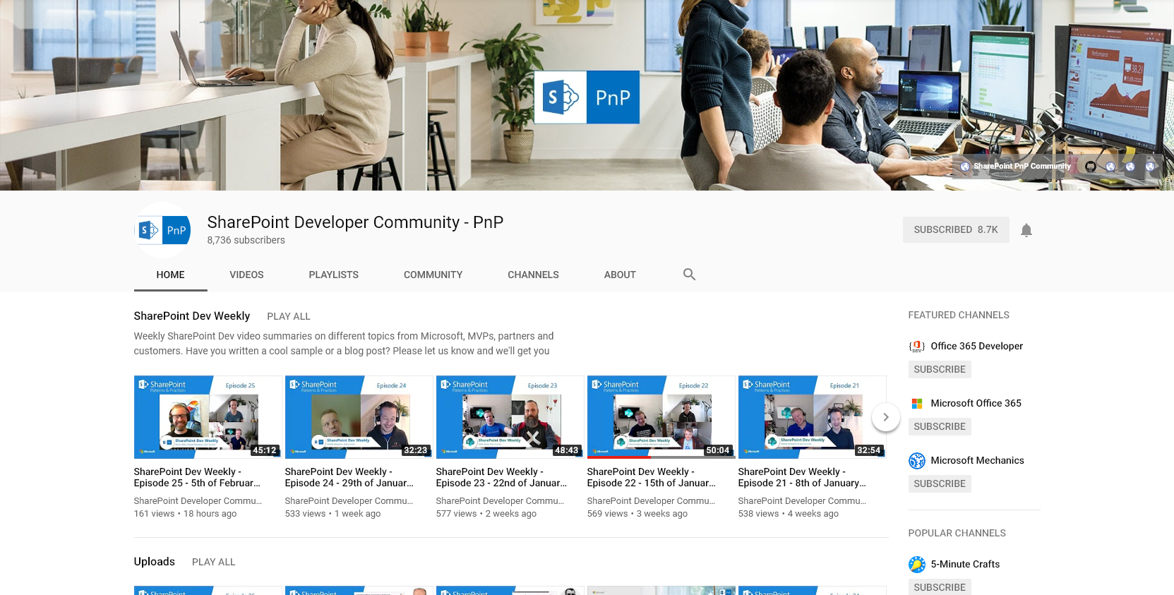

Slide 27
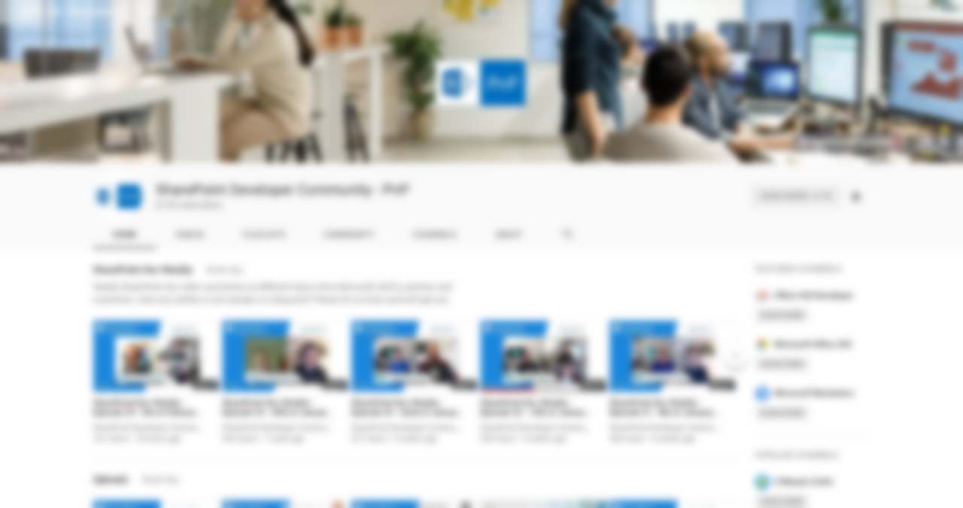


Web cast recordings
Quick Guidance Videos
Tutorial Videos
Training Videos
Community call recordings
350+ videos!
Slides
slideshare.net/sharepointpnp

Slide 28

aka.ms/spdev-samples

Slide 29
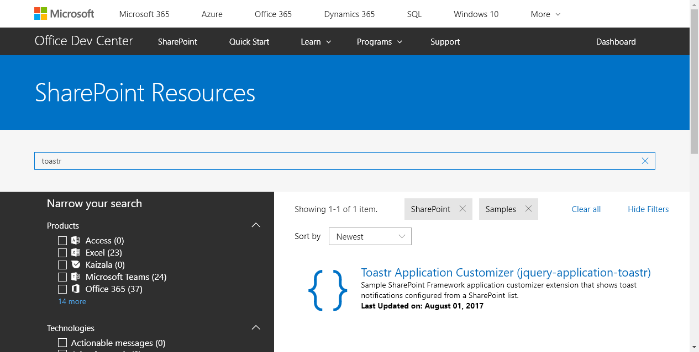

Slide 30
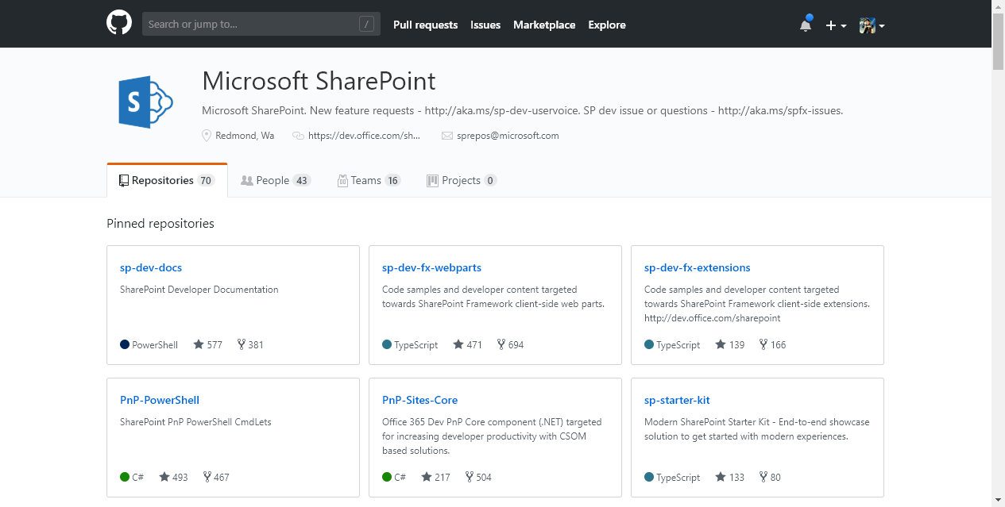



GitHub.com/SharePoint
&
GitHub.com/PnP

Slide 31


Slide 32

Demo: GitHub Basics
Notes:
Show off the Download Zip button
Navigate directly to files in Github

Slide 33


Slide 34



Tenant Administration
Remote Provisioning
Programmatic Configuration
And More
2013, 2016, O365 (2019 soon)
Works with (not replaces) SP PowerShell
Run from YOUR machine
PNP PowerShell
aka.ms/sppnp-powershell

Slide 35
PnP-PowerShell Cmdlets
aka.ms/sppnp-powershell
360+ CmdLets
Apps (12)
Base Cmdlets (18)
Branding (20)
Client-Side Pages (9)
Content Types (9)
Diagnostic Utilities (3)
Document Sets (5)
Event Receivers (3)
Features (4)
Fields (7)
Files and Folders (18)
Information Management (8)
Lists, Views, & Items (18)
Microsoft Graph (13)
Provisioning (29)
Publishing (13)
Records Management (9)
Search (5)
SharePoint Recycle Bin (5)
SharePoint WebHooks (4)
Sites (14)
Taxonomy (17)
Tenant Administration (61)
User and Group Management (12)
User Profiles (5)
Utilities (1)
Web Parts (11)
Webs (17)
Workflows (10)

Slide 36
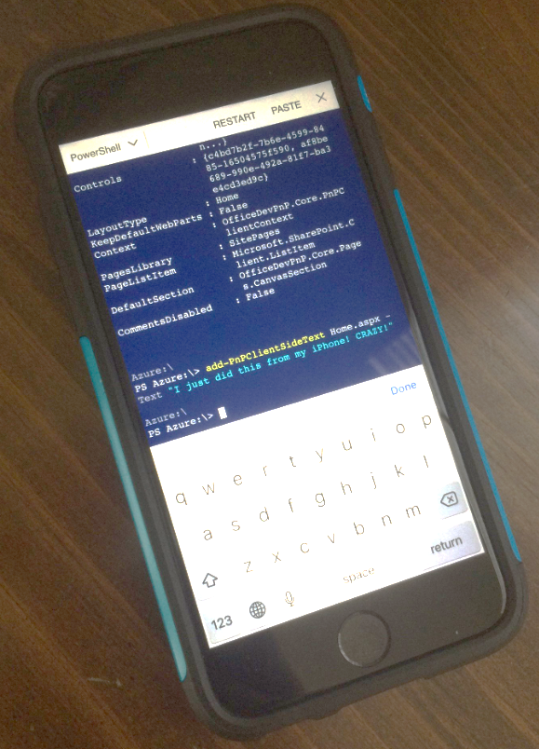
PnP-PowerShell Cmdlets
aka.ms/sppnp-powershell
340+ CmdLets
Apps (12)
Base Cmdlets (17)
Branding (20)
Client-Side Pages (9)
Content Types (9)
Diagnostic Utilities (3)
Document Sets (5)
Event Receivers (3)
Features (4)
Fields (7)
Files and Folders (18)
Information Management (6)
Lists, Views, & Items (18)
Microsoft Graph (13)
Provisioning (13)
Publishing (13)
Records Management (9)
Search (5)
SharePoint Recycle Bin (5)
SharePoint WebHooks (4)
Sites (14)
Taxonomy (17)
Tenant Administration (61)
User and Group Management (12)
User Profiles (5)
Utilities (1)
Web Parts (11)
Webs (17)
Workflows (10)
Running on an iPhone using the Azure App!
But… why?
Because it’s
AWESOME

Slide 37
Important Basic Cmdlets
aka.ms/sppnp-powershell
Cmdlet | Description | Platforms
Connect-PnPOnline | Connects to a SharePoint site and creates a context that is required for other PnP Cmdlets (Do this first) | All
Get-PnPContext | Returns a Client Side Object Model context | All
Disconnect-PnPOnline | Disconnects the context (Do this last) | All
Connect-PnPOnline https://mytenant.sharepoint.com/sites/MySite -CurrentCredentials
https://thechriskent.com/2018/02/14/using-sharepoint-pnp-powershell-modules-side-by-side-2013-2016-online/

Slide 38

Demo: PnP PowerShell
Notes:
Connect-PnPOnline https://thechriskent.sharepoint.com/sites/fun
Add-PnPClientSidePage -Name "Magic" –CommentsEnabled
Add-PnPClientSideText -Page "Magic" -Text “Yo dawg, welcome to my site"
Add-PnPClientSideWebPart -Page "Magic" -DefaultWebPartType BingMap -WebPartProperties "{pushPins:[{title:'Home Sweet Home',address:'Plainfield, IN'}],center:{latitude:39.7044,longitude:-86.3978,altitude:0,altitudeReference:-1},zoomLevel:13}"

Slide 39

Pretty much everything
(as long as there is a CSOM API)
Site Columns
Content Types
Lists
Data Rows
Pages
Custom Actions
Remote Provisioning

Slide 40


PnP Provisioning Engine
Uses the Client Side Object Model (CSOM) to provision artifacts instead of using the Feature Framework
Removes the need to use declarative XML! (mostly)
Can use the SharePoint UI to create artifacts
Creates a Template file
Easy to add to source control, move between environments, etc.
Applies as Diff
Non-Destructive – your content is safe
Can be reapplied as templates evolve

Slide 41
Remote Provisioning Supported Environments
SharePoint 2013
Minimum required version: April 2015 CU
Full functionality required version: January 2016 CU
SharePoint 2016 (2019 soon)
SharePoint Online
Best Coverage
Includes full support for SPFx Web Parts & extensions
Modern pages, Modern sites

Slide 42
Important Provisioning Cmdlets
Cmdlet | Description | Platforms
Get-PnPProvisioningTemplate | Generates a provisioning template from a web | All
Apply-PnPProvisioningTemplate | Applies a provisioning template to a web | All
Connect-PnPOnline https://mytenant.sharepoint.com/sites/MySite -CurrentCredentials
Get-PnPProvisioningTemplate -Out MyTemplate.xml
Disconnect-PnPOnline
PowerShell NOT required, can also be done from .NET

Slide 43

Site Designs & Remote Provisioning
O365 Modern Site Provisioning
JSON Schema
Add Lists & Fields
Add Navigation Links
Set Theme and Logo
Join Hub Site
And More!
Trigger a Flow
Flow
Http Call
Azure Queue
Azure Function
Apply Template
Additional Configuration
https://docs.microsoft.com/en-us/sharepoint/dev/declarative-customization/site-design-pnp-provisioning

Slide 44

Demo: Remote
Provisioning
Notes:
Create list on Model site with 1 or 2 columns
Create new Comm site Target, go to site contents
Connect-PnPOnline https://thechriskent.sharepoint.com/sites/Model
Get-PnPProvisioningTemplate -Out "MyTemplate.xml" -Handlers Lists
Disconnect-PnPOnline
Open MyTemplate.xml
Connect-PnPOnline https://thechriskent.sharepoint.com/sites/Target
Apply-PnPProvisioningTemplate -Path "MyTemplate.xml" -Handlers Lists
Disconnect-PnPOnline

Slide 45

Demo: Site Design with
Remote Provisioning
Notes:
Create Site
Show MySpecialTemplate.xml
Show Site Design JSON

Slide 46
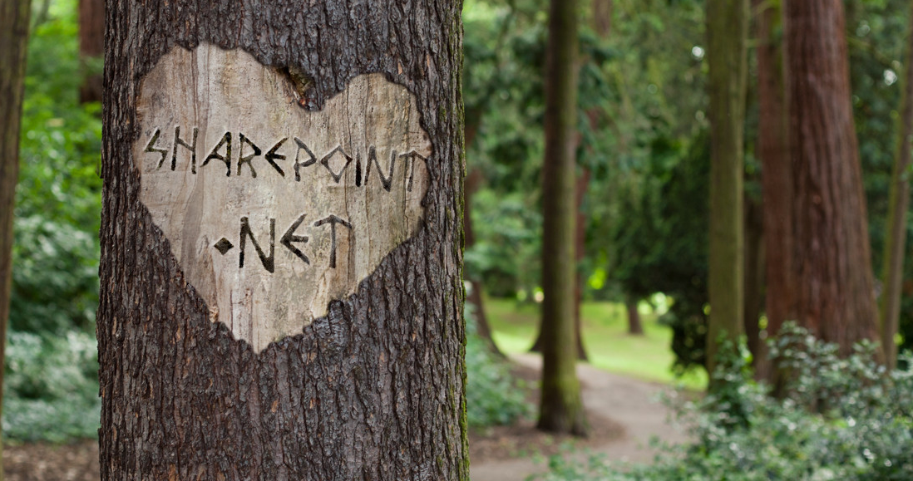
.NET Library for the Client Side Object Model
Extends methods
Adds methods
Simplifies & Enhances
2013, 2016, O365 (2019 soon)
Powers PnP PowerShell
NuGet Package
+
PNP CSOM Core

Slide 47

Classic Pages to Modern
Page Transformation via:
PowerShell
.NET
The Ribbon
Modernization Scanner
Page Transformation
aka.ms/sppnp-pagetransformationui

Slide 48


Fluent API
Batching
Caching
The best way to access the REST API via JS
PnPJS

Slide 49
Choose your functionality (Available as npm packages and via CDN)
@pnp/common
@pnp/config-store
@pnp/graph
@pnp/logging
@pnp/nodejs
@pnp/odata
@pnp/pnpjs
@pnp/sp
@pnp/sp-addinhelpers
Rollup (mimics sp-pnp-js)
Fluent API for SharePoint REST
Traditional Approach: string concatenation
api/web/lists/getbytitle(‘Things’).items?$select=Title,Author/Id$expand=Author&$top=50

Slide 50

PnPJS: Fluent API
Traditional Approach: string concatenation
api/web/lists/getbytitle(‘Things’).items?$select=Title,Author/Id$expand=Author&$top=50

Slide 51

Cross Platform Command Line Interface
Perfect for DevOps
“Faster” than PnP PowerShell but not yet equivalent coverage
Best way to upgrade your SPFx Solution
Office 365 CLI
aka.ms/O365cli

Slide 52

SPFx Property Pane Controls
SPFx React Controls
Extends the Property Pane
24 Controls
List Picker, Color Picker, Collection Data, People Picker, Date Time Picker, Number, Spin Button, etc.
Using React is much easier
33 Controls
Taxonomy Picker, ListView, Map, Charts, Field Renderers, WebPart Title, Breadcrumb, Placeholder, etc.
Reusable SPFx Controls

Slide 53
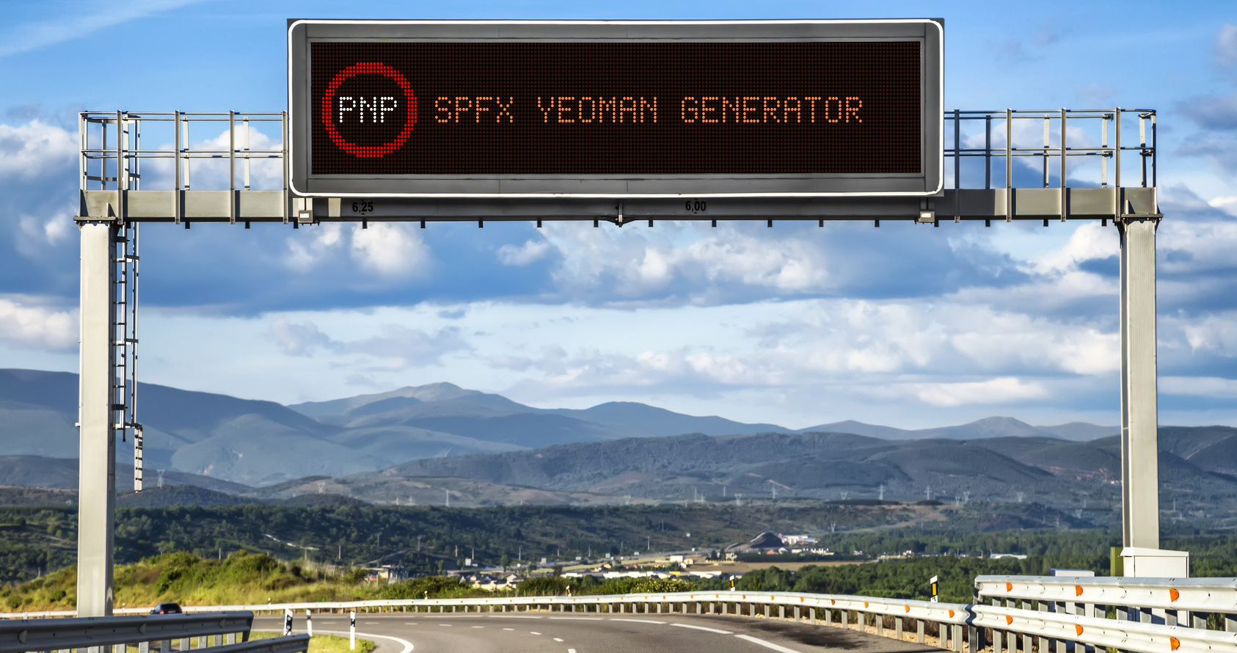
Extends standard SPFx Generator
Simplifies adding external libraries
jQuery, PnPJS, Reusable Controls, etc.
Adds additional framework support
Handlebars, VueJS, Angular Elements, etc.
PnP SPFx Generator
aka.ms/pnpgenerator

Slide 54

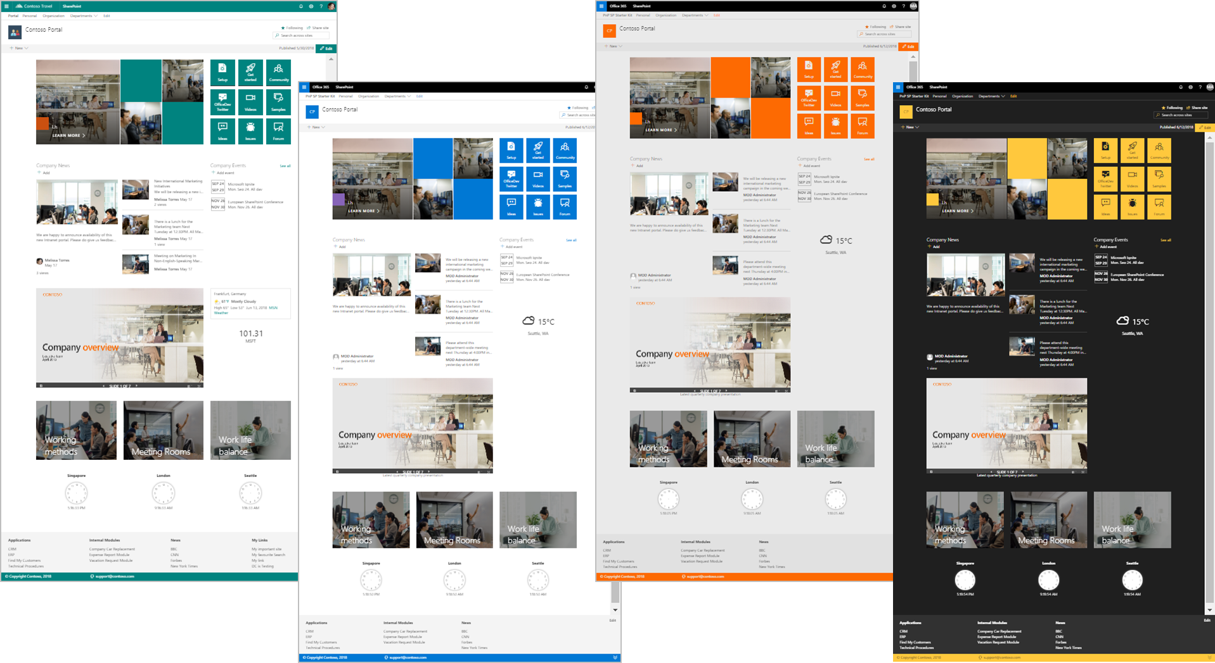
End-to-End modern experience
Multiple SPFx webparts & Extensions
Site Designs & Themes
Deployment Scripts
SP Starter Kit
aka.ms/spdev-starter-kit

Slide 55

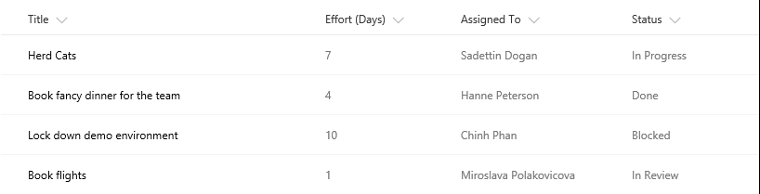
The Modern Listview
Responsive
Fancy
Boring
No XSLT
No Calculated Column Trickery

Slide 56


Dapper
The Modern Listview

Slide 57

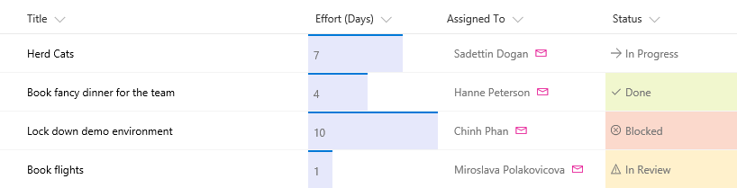

Slide 58
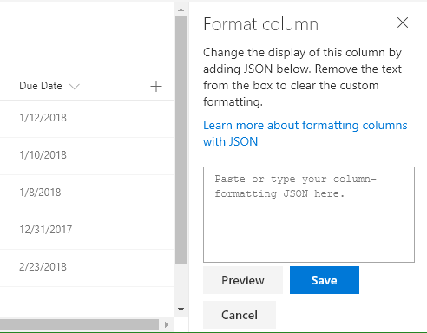
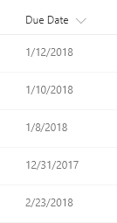

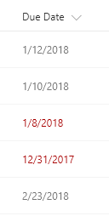



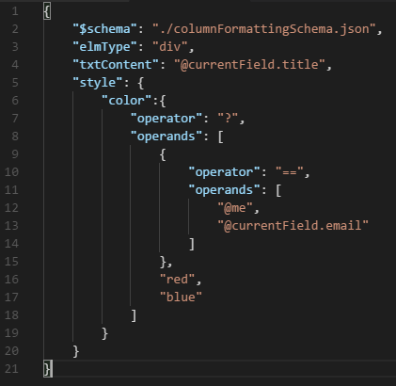

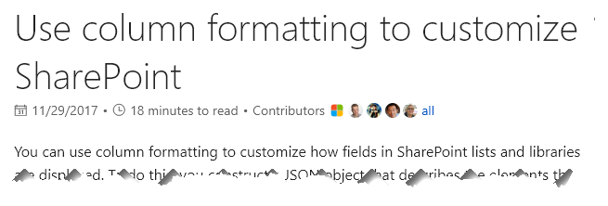




Todd
the Hero
Sad

Slide 59
Formerly Column Formatter
List Formatter Easy editor for modern list view Formatting
Official Update Coming Soon
github.com/SharePoint/SP-Dev-Solutions/tree/master/Solutions/ColumnFormatter

Slide 60
Demo: List Formatter

Slide 61
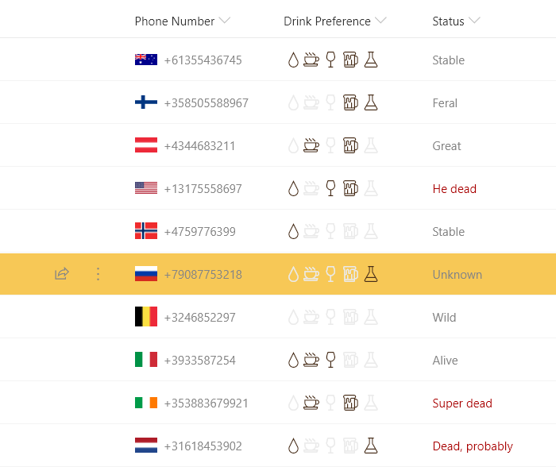
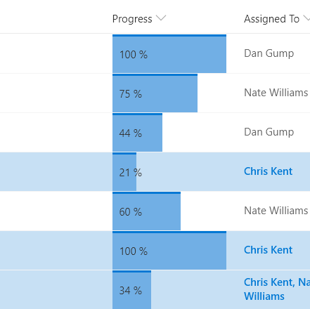
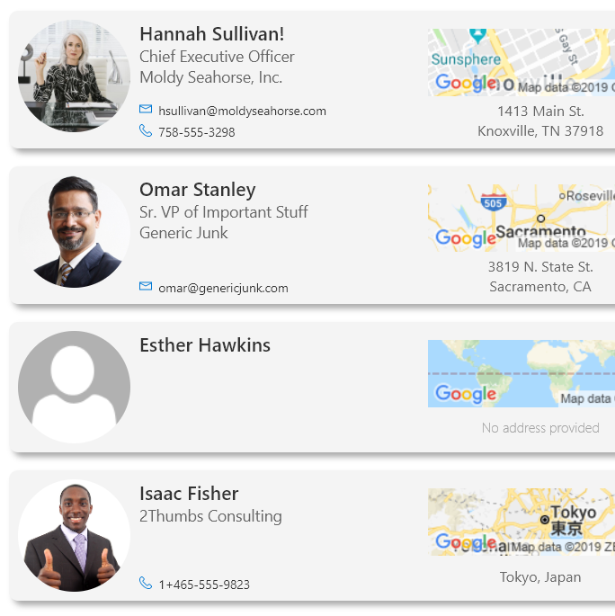
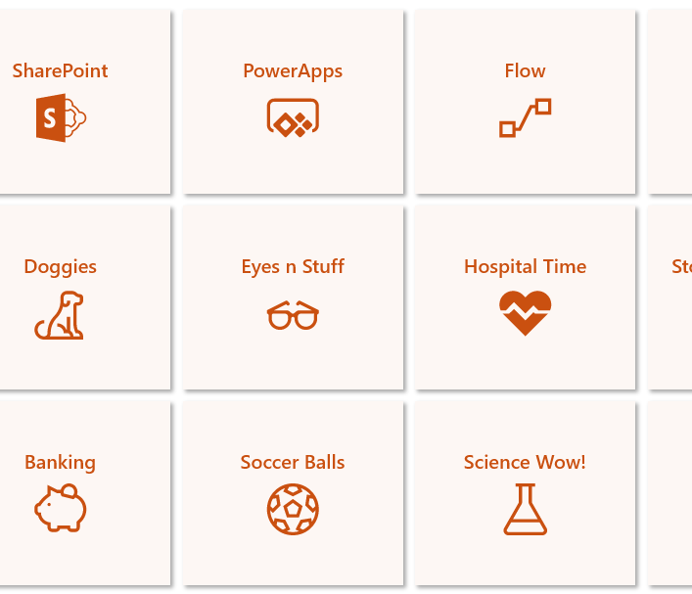
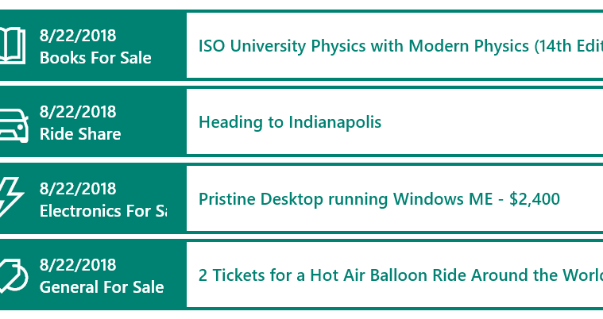
O365 List Formatting to the Rescue
Wednesday, 1:45 pm | Salon G
Column Formatting
View Formatting
PnP List Formatter
And more!

Slide 62


Slide 63

Contribution Opportunities
Join the calls and talk in the chat
Add an idea to UserVoice
Fix the documentation
Report an Issue
Fix some code
Present on the call
Add a sample

Slide 64

Thank you for your assistance within last month!
Albert-Jan Schot (Mavention) – @appieschot
Alex Terentiev (SharePointalist) – @alexaterentiev
Andrew Connell (Voitanos) – @andrewconnell
Andrew Koltyakov (ARVO Systems) – @andrewkoltyakov
Antons Mislevics – antonsmislevics
Balamurugan Kailasam – kshsbala
Chris Kent (DMI) – @theChrisKent
Christian Zuellig (MondayCoffee AG) – czullu
Daniel Laskewith (Sogeti) – @laskewitz
David – davidcfk
David Warner II (Catapult) – @DavidWarnerII
Elio Struyf – @eliostruyf
Erwin van Hunen (Rencore) – @erwinvanhunen
Eric Shupps – @eshupps
Eric Skaggs (Catapult Systems) – @skaggej
Eric Overfield (Pixelmill) – @EricOverfield
Frank Cornu (aequos) – @FranckCornu
Gautam Sheth (Rapid Circle) – @gautamdsheth
Hugo Bernier – bernierh
Jake Stanger – JakeStanger
Jakob Nøtseth (CrediCare) – @net_freak
Jens Otto Hatlevold (Bouvet AS) – jensotto
João Mendes – @joaojmendes
Joel Rodrigues (CPS) – @JoelFMRodrigues
Kyle Schaeffer (Spiritous) – @kyleschaeffer
Laurent Sittler (Saegus) – @laul0_68
Luis Mañez (ClearPeople) – @luismanez
Marc D Anderson (Sympraxis Consulting) – @sympmarc
Mikael Svenson (Puzzlepart) – @mikaelsvenson
Oleksandr Yatsenko – Oleksandr-Yatsenko
Paolo Pialorsi (PiaSys.com) – @PaoloPia
Paul Schaeflein – @paulschaeflein
Pieter Veenstra (Triad Group Plc) – @PieterVeenstra
Piotr Siatka (Valo Intranet) – @PiotrSiatka
Radi Atanassov (OneBit Software) – @RadiAtanassov
Russel Gove – @russgove
Sebastien Levert (Valo Intranet) – @sebastienlevert
Simon Ågren (Sogeti) – @agrenpoint
Spencer Harbar (ClearPeople) – @harbars
Stefan Bauer (n8d) – @StfBauer
taraldga alias – taraldga
Thomas Berman (Cadenza Software) – thomasberman
Tahir Naveed – @NooriNath
Tomi Tavela (Valo Intranet) – @tavikukko
Vardhaman Deshpande (Content and Code) – vrdmn
Waldek Mastykarz (Rencore) – @waldekm
Velin Georgiev – @velingeorgiev
Vincent Biret (2toLead) – @baywet
ytterstrom alias – ytterstrom

Slide 65



















Companies involved with January 2019 release
Companies which provided support for PnP initiative by allowing their employees to contribute to our open source projects
These are companies, from where we got approval to use their logo
You contributed and your company is not here? – Send us an email with your permissions and logo

Slide 66
Demo: GitHub Contributions
Notes:
Fork button
Edit button
Submit Pull Request

Slide 67


Bi-Weekly
SP General Development
aka.ms/sppnp-core-sig-call
PowerShell, Provisioning, CSOM
Next Call: Thursday, 2/21
Bi-Weekly
SharePoint Framework
aka.ms/sppnp-js-sig-call
SPFx, PnP JS Core
Next Call: Thursday, 2/14
Monthly
Community Calls
aka.ms/sppnp-call
Monthly Summary
Next Call: Tuesday, 2/12

Slide 68



Official Blog
dev.office.com/blogs
Twitter
@OfficeDevPnP
Tech Community
aka.ms/sppnp-community

Slide 69

THANK YOU
Use it!
Awesome stuff out there
See a problem
Have an idea
Need help
Fix it!
Suggest it!
Reach out!

